Slide 1
Event Hub and Notification Hub
Sergio Andrés Vargas Acosta
Core Director AppFuture Group
@serandvaraco - svargas@appfuture.net

Slide 2
Notificaciones
Notes:
Slide Objectives:
Explain how Azure helps developers to refocus on their applications.
Speaker Notes:
Before we discuss about specifics, let’s refocus on what you care about – your application/service.
Azure is taking a application-centric approach and brings tools and services to support DevOps scenarios.

Slide 3

Difunda a millones de dispositivos en minutos

Slide 4

Funciona con cualquier back-end

Slide 5

Diseñado para escalados de gran volumen

Slide 6
Eventos
Notes:
Slide Objectives:
Explain how Azure helps developers to refocus on their applications.
Speaker Notes:
Before we discuss about specifics, let’s refocus on what you care about – your application/service.
Azure is taking a application-centric approach and brings tools and services to support DevOps scenarios.

Slide 7
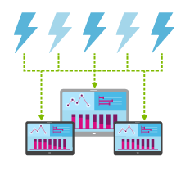
millones de eventos por segundo en múltiples aplicaciones

Slide 8

Conecte millones de dispositivos de distintas plataformas

Slide 9
Contacto
Sergio Andrés Vargas Acosta
Core Director AppFuture Group SAS
@serandvaraco - svargas@appfuture.net
http://appfuture.net/

